Slide 1

EE 3702 – Analog Circuits Lab
0-0-3-2 Credits
Course Instructor: Dr. Prashanth Vooka
Electrical Department
IIT Tirupati

Slide 2
Lab Experiments:
Familiarity with Lab components
CAD Simulation Software Exercise 1
CAD Simulation Software Exercise 2
OpAmp based experiments
Transistor based experiments

Slide 3
Marks Distribution
Internal (Daily assessment, Lab preperation, Daily viva) – 60 marks
End Sem Exam (exam, viva voce)– 40 marks
DAY | 1 | 2 | 3 | 4 |  | 5 | 6 | 7 | 8
 | 9.00 -9.50am | 10.00 -10.50am | 11.00 -11.50am | 12.00 -12.50pm | Lunch recess 1.00 pm –2.00 pm | 2.00 -2.50pm | 3.00 -3.50pm | 3.55 -4.45pm | 4.50 -5.40pm
Mon
Tue
Wed
Thu |  |  |  |  |  |  | EE3702 Analog Circuits Lab
Fri

Slide 4
EE 3003 - Power Systems
3-1-0-4 Credits
Course Instructor: Dr. Prashanth Vooka
Electrical Department
IIT Tirupati

Slide 5
Course Content :
Introduction to Power Systems: Historical developments, performance requirements, typical power station and substation layout, single line diagram, conventional and non-conventional electrical energy sources-recent trends.
Transmission and Distribution Systems: overhead lines, insulators, underground cables, distribution systems.
Power system analysis: Modeling of power system components, basics of load flow analysis, power system stability.
Power system protection: Switchgear, fuses, circuit breakers, symmetrical fault calculations-basic principles of protection relays.
Economics of power supply system: Economic load dispatch without losses, unit commitment.

Slide 6
Text Books :
1. Power system Analysis: John J. Grainger and William D. Stevenson, Tata McGraw-Hill, 2003.
2. Power system analysis: Hadi Saadat, Tata McGraw-Hill, 2002.
Reference Books :
1. Electrical energy systems theory an introduction: Olle l. Elgerd, T M H Edition
2. Power system stability and control: P. Kundur, Tata McGraw-Hill, 2006.
3. Modern Power Systems Analysis: I. J. Nagrath and D. P. Kothari, Tata McGraw-Hill, 2005.
4. Electrical Power Systems: CL Wadhwa, New age international Publishers

Slide 7
Marks Distribution
Quiz 1 – 20 marks
Quiz 2 – 20 marks
End Sem – 45 marks
Tutorial/Assignment – 15 marks
DAY | 1 | 2 | 3 | 4 |  | 5 | 6 | 7 | 8
 | 9.00 -9.50am | 10.00 -10.50am | 11.00 -11.50am | 12.00 -12.50pm | Lunch recess 1.00 pm –2.00 pm | 2.00 -2.50pm | 3.00 -3.50pm | 3.55 -4.45pm | 4.50 -5.40pm
Mon |  |  | C*
Tue |  |  |  |  |  | C*
Wed | C*
Thu | C*
Fri

Slide 8
Contents:
POWER SYSTEMS - INTRODUCTION
What is power system ?
Evolution of Power system in India.
Grid Interconnection.
Standard Statistics about Indian Power Generation
Bibliography

Slide 9
Power System
Every large-scale power system has three major components:
generation: source of power, ideally with a specified voltage and frequency
load or demand: consumes power; ideally with a constant resistive value
transmission system: transmits power; ideally as a perfect conductor
Additional components include:
distribution system: local reticulation of power (may be in place of transmission system in case of microgrid),
control equipment: coordinate supply with load.

Slide 10
Power System Examples
Interconnection: can range from quite small, such as an island, to one covering half the continent:
Airplanes and Spaceships: reduction in weight is primary consideration; frequency is 400 Hz.
Ships and submarines.
Automobiles: dc with 12 volts standard and higher voltages used in electric vehicles.
Battery operated portable systems.

Slide 11
Complications
No ideal voltage sources exist.
Loads are seldom constant and are typically not entirely resistive.
Transmission system has resistance, inductance, capacitance and flow limitations.
Simple system has no redundancy so power system will not work if any component fails.

Slide 12
POWER SYSTEM COMPONENTS
Generation
Primary Transmission(132/220/400/765KV)
CB
Power Plant
220 kV
X’mer
Primary Grid
Bus-bar
(11/220kV)
CB
Steel Tower
(220/66 kV)
Bus-bar
Commercial/
66 kV
Industrial
Transmission
Customer
(11/0.415 kV)
Secondary Transmission (66/132KV)
Distribution Transformer
Primary Distribution
Urban
Customers
Secondary Grid
Secondary Distribution
(66/11 kV)
Distribution
Pole
Underground Cable
To Other
Residential
Residential
66KV
Customer
Customer
Substations

Slide 13
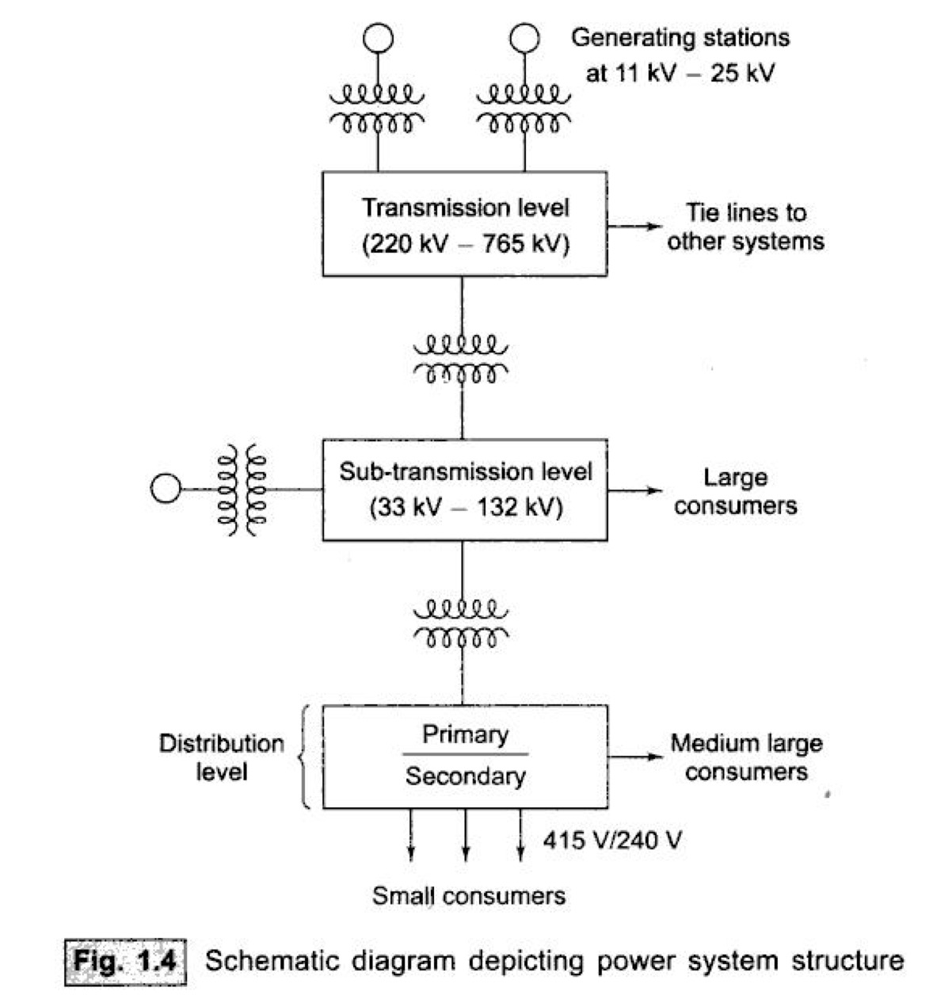
Ref: Nagrath and Kothari

Slide 14
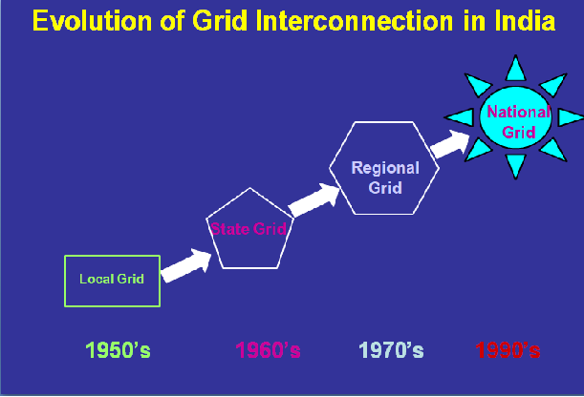
EVOLUTION OF POWER SYSTEM IN INDIA
Pre Independence - Small Isolated System
Prior to 60s - Generation/ Transmission By State Electricity Boards
During 60s - Limited Interconnection Between Neighboring States
70s - Emergence Of Central Sector on planning of generation/transmission on regional basis ( NTPC, etc.)
Late 80s – Integrated Grid Operation Through 400kv System
Late 90s - asynchronous inter regional links long distance hvdc links / b2b stations

Slide 15
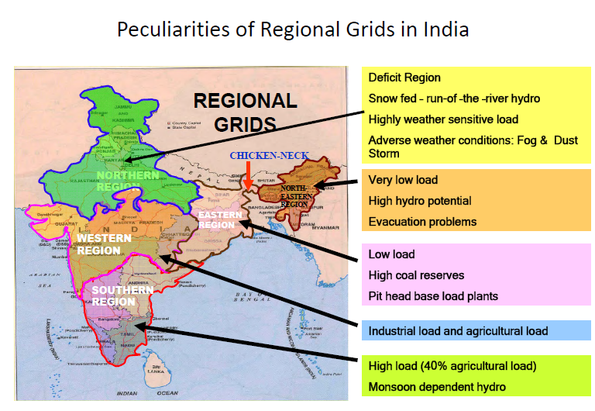

Slide 16
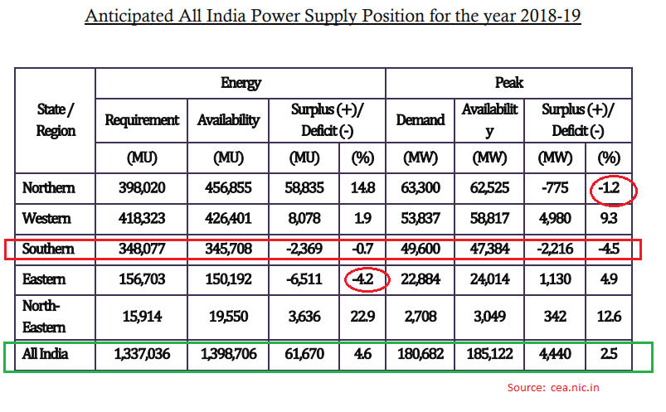

Slide 17
August 2006
North synchronized
With Central Grid
Five Regional Grids
Two Frequencies
March 2003
West synchronized
With East & Northeast
NEW Grid
October 1991
East and Northeast
synchronized
South
Grid
Dec-2013 South Synch with new grid
Central Grid
MERGING
OF
MARKETS
North
East
West
Northeast
South
Inter – Regional
Capacity:
22 GW
Five Regional Grids
Five Frequencies

Slide 18
NATIONAL GRID :THE ADVANTAGES
Strong backbone ‘anywhere to anywhere’ trading
Economic operation
Optimal utilization of scarce national resources
Added stability
Boundary-less operation
THE NATIONAL GRID ENVISAGED BY POWERGRID IS A HYBRID NETWORK COMPRISING A 765 kV HUB WITH 400 kV AC AND 500kV HVDC

Slide 19
International Interconnections
Nepal
Bhutan
Over 16 links of 132/33/11 KV
Radial links with Nepal
Net import by Nepal
Tala: 1020 MW
Chukha: 336 MW
Kurichu: 60 MW
Net import by India
Bangladesh
400 KV AC line between Baharampur (India) and Bheramara(Bangladesh) with 500 MW HVDC sub-station at Bheramara
Sri Lanka Madurai Madurai (India) and Anuradhapura (Sri-Lanka) through ±500 KV HVDC under sea cable
Maps not to scale

Slide 20
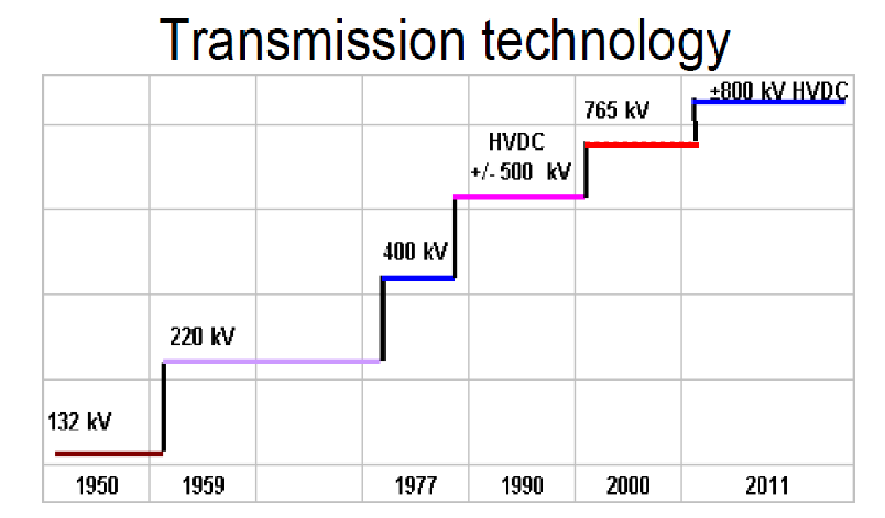

Slide 21
Power
Power:
Instantaneous rate of consumption of energy,
How hard you work!
Power = voltage x current for dc
Power Units:
Watts = amps times volts (W)
kW – 1 x 10³ Watt
MW – 1 x 10⁶ Watt
GW – 1 x 10⁹ Watt

Slide 22
Energy
Energy:
Integration of power over time,
Energy is what people really want from a power system,
How much work you accomplish over time.
Energy Units:
Joule = 1 watt-second (J)
kWh – kilowatthour (3.6 x 10⁶ J)

Slide 23
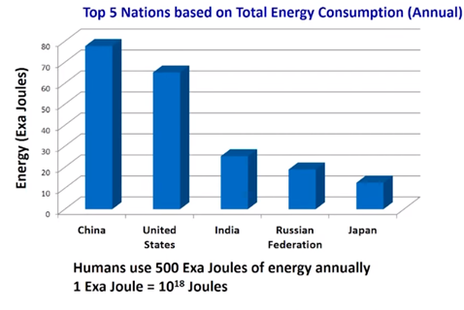
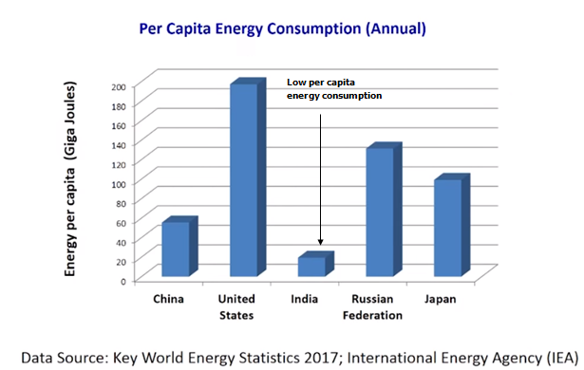

Slide 24
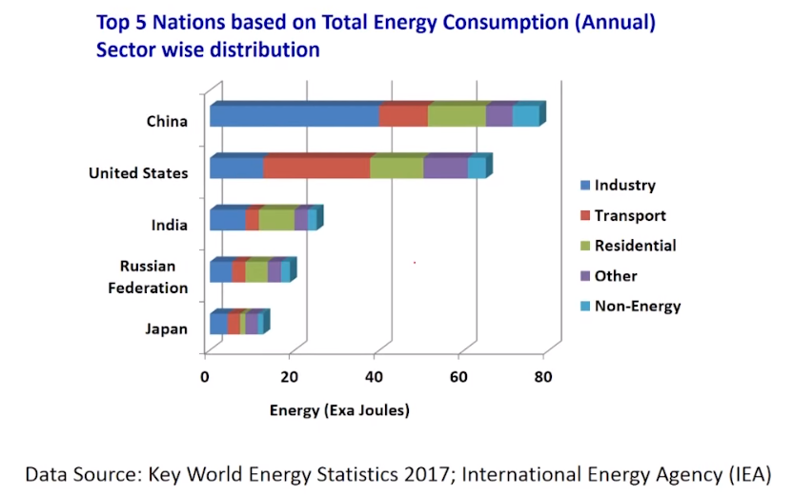

Slide 25
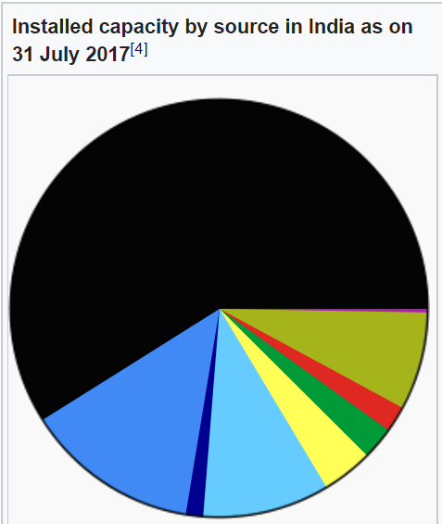
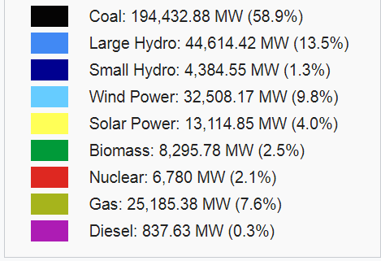
Source: Wikipedia

Slide 26
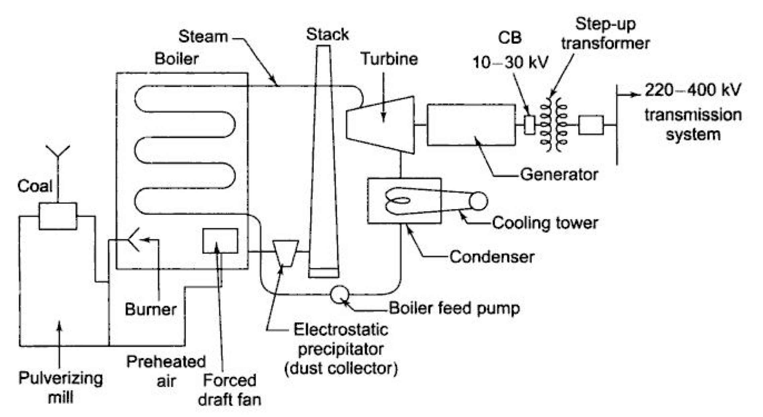
Coal Fired Steam Plant
Source: Nagrath and Kothari

Slide 27
Bibliography
International Energy Agency
Wikipedia
Central Electricity Authority
National power Training Institute Reports
NASA and other research organisations.

